Slide 1
Cloud Solution Architect
Module 2
Lecture 8
ssh server, iptables, firewalls, web servers

Slide 2
Recap
Module 2 - Lecture 7
  Advanced commands

Slide 3
Learning Objectives
Module 2 - Lecture 8
  SSH server
  Firewall
  Iptables
  web server

Slide 4
SSH Server
  Stands for "Secure SHell"
  A protocol to securely connect to a remote server/system
  Transfers the data in encrypted form between the host and the client
  runs at TCP/IP port 22
  To install and run ssh
    sudo apt install openssh-server
    sudo systemctl status ssh
    sudo systemctl enable ssh
    sudo systemctl start ssh

Slide 5
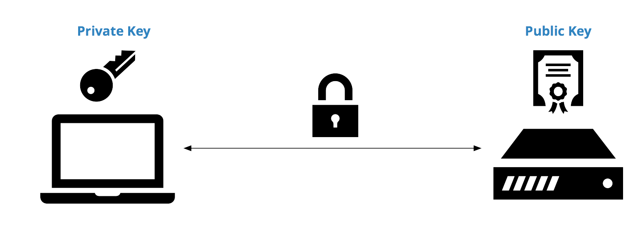
Public Key Infrastructure
  It is a trust infrastructure that issues and manages digital, cryptographically secure credentials to devices.
  It provides integrity, authenticity, and protection of digital information and transactions

Slide 6
Public Key Infrastructure
  to generate public-private keys, use the command
    ssh-keygen
  this will create two keys
    private key, stored in ~/.ssh/id_rsa
    the public key, stored in ~/.ssh/id_rsa.pub
  The private key must be kept secret, whereas the public key must be copied to the remote host in ~/.ssh/authorized_keys to access without a password
  The first time a remote machine is accessed, the remote machine will automatically be saved in ~/.ssh/known_hosts on the client machine

Slide 7
SSH Server
  ssh command consists mainly of 3 parts
    'ssh' command
      instructs the system to establish an encrypted secure connection with the host machine
    'user_name'
      the account that is being accessed on the host
    'host'
      refers to the machine which can be a router or a computer that is being accessed
      it can be an IP address or domain name
  After logging in, commands will work on the host (remote) machine

Slide 8
SSH access
  To access a remote host, use the command
    ssh root@10.10.10.10
    This will create a secure connection and access the machine at 10.10.10.10 with the root user
  X11 Forwarding
    ssh -X root@10.10.10.10
    This will create a secure connection with X11 forwarding enabled, which means any application opened in the remote host will be forwarded to display on the local machine
  Port Forwarding
    ssh -L 63000:10.10.10.10:2365 root@10.10.10.11
    port 63000 on the local machine, will access 10.10.10.11 and forward the data to port 2365 on 10.10.10.10 from there

Slide 9
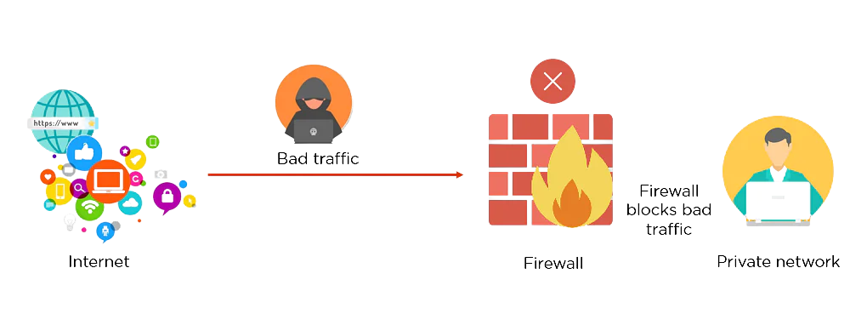
Firewall
  A network security system that monitors and controls the incoming and outgoing network traffic based on predefined rules.
  It typically establishes a barrier between a trusted network and an untrusted network
  A firewall can be a software firewall, hardware firewall, or both.

Slide 10
Firewall
  Packet filtering: controls the flow of incoming and outgoing network data
  stateful inspection: determine which packets to allow through
  stateful multilayer inspection: a sophisticated form of packet filtering that examines all seven layers of the OSI model
  proxy firewall: gateway between internal users and the internet
  Network Address Translation (NAT) firewall: operates on a router to protect private networks

Slide 11
Firewall - ufw
  Ubuntu has its own firewall, known as the uncomplicated firewall, ufw
  simplified process of configuring a firewall
  install ufw using: sudo apt install ufw
  Default configuration can be found at /etc/default/ufw
  Setting up Default policies
    sudo ufw default deny incoming
    sudo ufw default allow outgoing
  View the app list in ufw
    sudo ufw app list
  To enable ssh
    sudo ufw allow OpenSSH //by application
    sudo ufw allow ssh //by service
    sudo ufw allow 22 //by port number

Slide 12
Firewall - ufw
  See the rules added
    sudo ufw show added
  after confirming the rules, enable the firewall
    sudo ufw enable
  to allow http / https
    sudo ufw allow http / sudo ufw allow https
    sudo ufw allow 80 / sudo ufw allow 443
  Allow port range
    sudo ufw allow 3000:3010/tcp
    sudo ufw allow 3000:3010/udp
  Allow IP addresses
    sudo ufw allow from 159.203.81.49

Slide 13
Firewall - ufw
  Deny Connections
    sudo ufw deny http
    sudo ufw deny from 159.203.81.49
    sudo ufw deny out 25
  Delete UFW rule by number
    sudo ufw status numbered
    sudo ufw delete [number-of-the-rule]
  delete by name, service or port
    sudo ufw delete allow "Apache Full"
    sudo ufw delete allow http
    sudo ufw delete allow 80
  Disable firewall
    sudo ufw disable
    sudo ufw reset

Slide 14
Firewall - Types
  There are some types of firewalls
  Web Application Firewall
  Network Segmentation Firewall
  Database Firewall
  Next-generation Firewall

Slide 15
Web Application Firewall
  WAF protects web applications from application-layer attacks
  based on a blocklist (negative security model) protects against known attacks
  based on an allow list (positive security model) admits pre-approved traffic
  a hybrid model that has both

Slide 16
Web Application Firewall
  Network-based WAF is hardware-based
    Most expensive
    requires hardware maintenance
  Host-based WAF may be fully integrated into an application's software
    offers more customizability
    consumption of local server resources
    implementation complexity
    maintenance cost
  Cloud-based WAF like Cloudflare
    affordable option
    turnkey installation
    Simple
    third party solution may make some features of WAF blackbox for the user

Slide 17
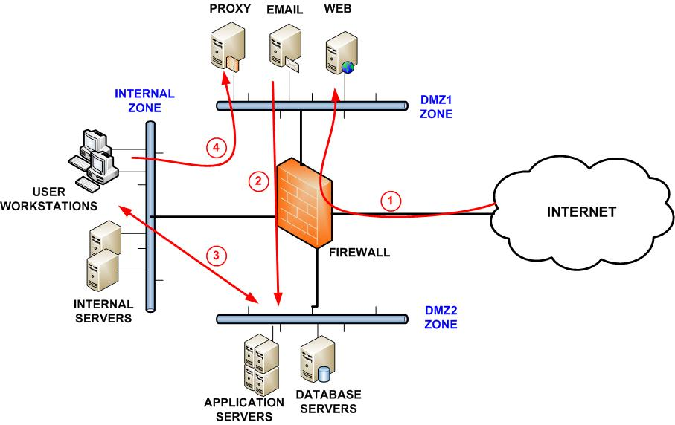
Network Segmentation Firewall
  The firewall is deployed at the desired network boundary
  Architects the network via physical links, or Virtual Area Networks (VLANs)
  Traffic that crosses the boundary is routed through the firewall

Slide 18
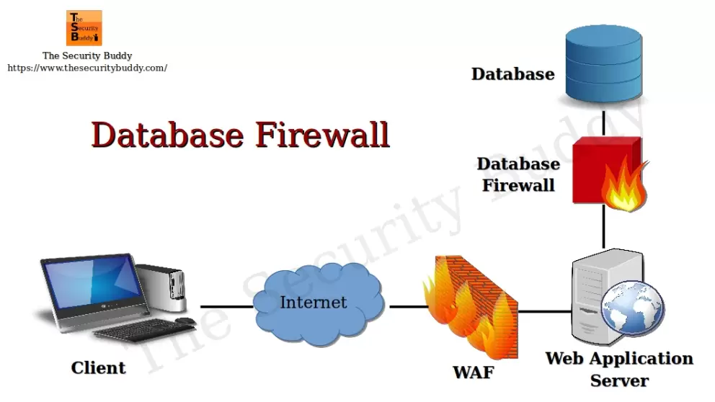
Database Firewall
  Protects against database specific attacks that seek to access sensitive information stored in databases

Slide 19
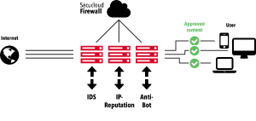
Next Generation Firewall
  Provides the functionalities of a traditional firewall along-with blocking modern threats such as advanced malware and application layer attacks

Slide 20
IPtables
  Used to set up and maintain tables for Netfilter firewall for IPv4.
  Matches packets with rules defined in these tables, and take specified actions on a possible match
  iptables have the following components
    Tables: A set of chains
    Chain: Collection of rules
    Rule: Condition used to match the packet
    Target: Action taken when a possible rule matches, values can be ACCEPT, DROP, QUEUE
    Policy: default action taken in case of no match with inbuilt chains and can be ACCEPT or DROP

Slide 21
IPtables - tables
  filter: Default table for packet filtering, includes chains like INPUT, OUTPUT, and FORWARD
  nat: related to Network Address Translation, includes PREROUTING and POSTROUTING chains
  mangle: specialized packet alteration, Inbuilt chains include PREROUTING and OUTPUT
  raw: configures exemptions from connection tracking. includes PREROUTING and OUTPUT
  security: used for mandatory access control

Slide 22
IPtables - chains
  INPUT: a set of rules for packets destined to localhost sockets
  FORWARD: for packets routed through the device
  OUTPUT: for locally generated packets, meant to be transmitted outside
  PREROUTING: for modifying packets as they arrive
  POSTROUTING: for modifying packets as they are leaving

Slide 23
IPtables - options
  -A, --append:
    append to the chain
      iptables [-t table] -A [chain] [parameters]
      iptables -t filter -A INPUT -j DROP
  -D, --delete:
    delete rule from specified chain
      iptables [-t table] -D [chain] [rule_number]
      iptables -t filter -D INPUT 2
  -C, --check:
    checks if a rule is present or not, returns 1 if it does, and 0 if doesn't
      iptables [-t table] -C [chain] [parameters]
      iptables -t filter -C INPUT -s 192.168.1.123 -j DROP

Slide 24
IPtables - options
  -L : List all the iptables
  -F : Flush all the rules in all the chains
  -p : a protocol that the packet follows, TCP, UDP, ssh, etc.
  -s : to match the source address of the package
  -d : to match the destination address of the package
  -i : matches packet with specified in-interface
  -o : matches packets specified out-interface
  -j : specifies the action to be taken on a match
  to save the iptables
    sudo iptables-save

Slide 25
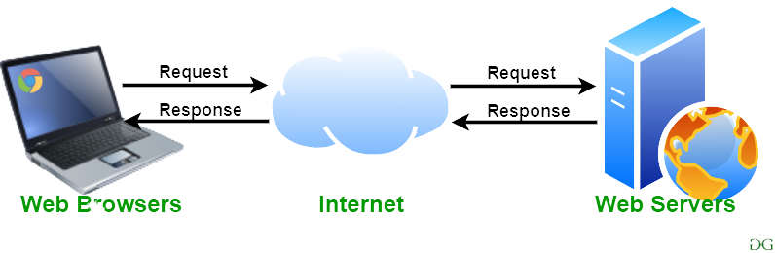
Web Server
  Program that processes the network requests of users and serves the files that create web pages
  This exchange is done using Hypertext Transfer Protocol (HTTP)

Slide 26





Web Server - Examples

Slide 27
Apache
  An Open Source Web Server
  used for Unix, Linux, Windows, and Solaris Platforms
  Developed by Apache Group
  initially released on 25 March 1999
  Written in C and XML
  Designed for web server
  Follows Multithread approach to process client requests
  dynamic content in web server itself
  Performance for static content is lower that Nginx

Slide 28
Nginx
  A web server, also used for reverse proxy
  for Linux and Unix like systems, does not completely support Windows
  Developed by Nginx Inc.
  Initially released on 4 October 2004
  Written in C language
  designed for proxy server as well as web server
  follows event driven approach to process client requests
  Does not support provide dynamic content
  Performance for static content is 2 times faster that Apache as it can run thousands of connections simultaneously, and uses less memory comparitively

Slide 29
Learning Objectives
Module 2 - Lecture 8
  SSH server
  Firewall
  Iptables
  web server

Slide 30
Next Lecture
Module 3 - Lecture 9
  Introduction to Cloud Interface
    AWS
    GCP
    Azure

Slide 31

Ask Questions!!

